Slide 1
Fibonacci Heaps
Advanced Data Structure

Slide 2
Introduction
Michael L. Fredman and Robert E. Tarjan
A collection of heap ordered trees
Fibonacci numbers appear in amortized analysis of these heaps
We’ll be discussing Min-heaps in subsequent sections.

Slide 3
Mergeable Heaps
Any data structure satisfying following properties:
Make_Heap(): returns a heap H that is empty
Insert(H,x): Adds a new element to H
Min(H): returns pointer to minimum element
Extract_Min(H): returns the minimum element and removes it from the heap
Union(H1,H2): merges H1 and H2 into a new heap

Slide 4
Other Operations
Along with operations of mergeable heap, fibonacci heap also support following operations:
Decrease_Key(H,x,k): decrease the key value of node x to new key k
Delete(H,x)

Slide 5
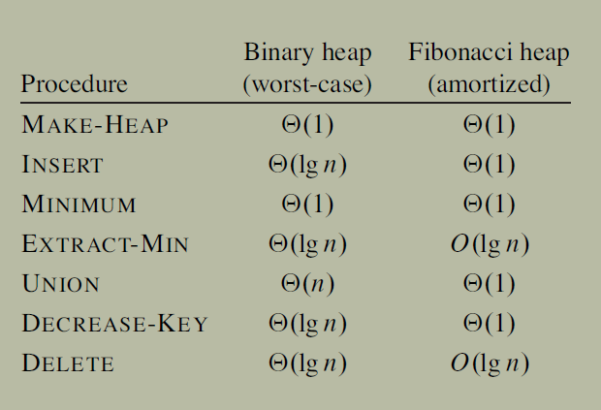
Comparison of running time
Time bounds of of fibonacci heaps are amortized bounds not worst case bound
Search(k): Finding the node with given key value takes _______time in both the cases, hence we’re supplying node pointers in our implementation of decrease-key and delete

Slide 6
Applications
Motivation: Priority queues where extract-min and delete operations are called lesser number of times compared to other ops. Eg: shortest path, MST (extract-min called only once per vertex).
Starting from an empty data structure, any sequence of a insert and decrease key operations and b extract-min operations would take O(a + b log n) worst case time, where n is the maximum heap size. Whereas in a binary heap such a sequence of operations would take O((a + b) log n) time.
Q: What would be time complexity of Dijkstra’s shortest path algorithm using Fibonacci heap?
Mostly of theoretical interest due to complex structure. From practical perspective, the constant factors within O notation are quite large so not as useful if n is not very large

Slide 7
Structure of Fibonacci Heaps
Collection of rooted trees that satisfy min-heap property
Each node contains a pointer to its parent and a pointer to any one of its children
The children are all linked together in a circular doubly linked list: insert-in/ delete- from/concatentate two such lists in O(1) time
Each node has two other attributes
Degree: number of nodes in child list
Mark: boolean – if x has lost a child. Unmarked when node is inserted for first time. Reset whenever the node is made a child of some other node
There’s a separate root-list circularly linking all root nodes
H.Min pointer points to the root with minimum key
H.n: number of elements in Fibonaccci heap
Upper bound on Maximum Degree= D(n)- We’ll see later that D(n)=O(lg(n)) in Fibonacci heaps.

Slide 8
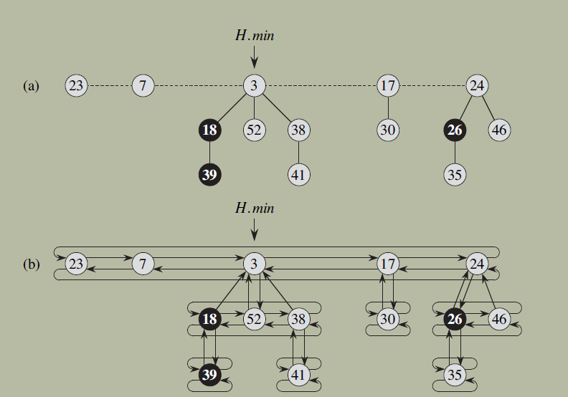
Example
(a) shows root list with min pointer
(b) shows left, right, p and child pointers as well

Slide 9
Operations
We shall discuss mergeable heap operations first:
Make_Heap()
Insert(H,x)
Min(H)
Extract_Min(H)
Union(H1,H2)
For analysis, we shall consider the potential function: φ(H)=t(H)+2*m(H)
t: number of trees in root list
m: number of marked nodes

Slide 10
Make-heap
Returns a new empty heap object H
H.n=0
H.min= NULL
t(H)=0
m(H)=0
φ=0
Amortized cost=actual cost=O(1)

Slide 11
Insert(H,x)
Node x has been created with
key -child and parent pointer pointing to NULL
X.degree=0 - x.mark=False
left and right pointer pointing to x itself.
Concatenate x to root list: No attempt is made to consolidate the trees at this point. K consecutive insert operations add k new singleton trees in root list.
Update H.min after comparison, increment H.n
H be heap before insert and H’ be after.
C’=1+ φ(H’)- φ(H) = 1+t’-t+2m’-2m = 2 [m’=m, t’=t+1]
Amortized cost=O(1)

Slide 12
Find-min(H)
We’re always maintaining H.min pointer.
Thus actual cost= O(1)
No change is made to t(H) or m(H) so potential remains same, therefore
amortized cost= actual cost= O(1)

Slide 13
Union(H1,H2)
Make new heap H
Min(H)=min(H1) [root list of H is same as that of H1 now]
Concatenate root list of H2 to H
Compare H.min and H2.min and allocate the smaller one to H.min (take care of comparison with NULL)
H.n= H1.n+H2.n
Destroy H1 and H2 objects and return H
Note: No consolidation of tree happens yet.
c’=O(1)+ φ (H)- [φ (H1)+φ(H2)]= O(1)
since t(H)=t(H1)+t(H2) & m(H)=m(H1)+m(H2)

Slide 14
Extract-min*
This is where the deferred work of consolidation finally happens
Steps:
z= H.min
If z=NULL, return z
Add each child of z to root list (and update their parent to NULL) and then remove z from root list.
If z==z.right (single node left in H) update H.min=NULL
Else let new min be z.right
Consolidate(H)
Decrement H.n by 1.

Slide 15
Consolidate(H)
Repeat following two steps until every root in root list has distinct degree value.
Find two roots x and y with same degree where x.key<=y.key
Link y to x: remove y from root list and make y a child of x- clear y.mark and increment x.degree
For the first point we maintain a hashtable- an array A[0,…D(n(H)]. A[i]=y means y is a node with degree i.
Scan new root list and set H.min correctly.

Slide 16
Extract-min Analysis
Actual cost
Extracting all children of H.min and placing in root list=O(D(n)) [any node has O(D(n)) children]
Size of root list when call to consolidate is made is <= D(n)+t(H)-1. Thus cost of consolidate= O(D(n)+t(H))
Actual cost= O(D(n)+t(H))
Potential difference:
φ(before)=t(H)+2m(H)
t(after)<= D(n)+1 [All trees have distinct degrees 0- D(n)], m(after)<=m(before)
Δ<= D(n)+1-t(H)
Amortized cost= O(D(n))

Slide 17
Other Operations
Decrease_Key(H,x,k)
Delete(H,x)

Slide 18
Decrease-key(H,x,k)
Recall: Decrease-key in normal heaps
If k > x.key throw newKeyGreaterThanOriginalEx
x.key=k
If x.p && x.key < x.p.key
x.key=x.p.key
Decrease-key(H,x.p,k)
This algo will lead to potential diff=0 and actual cost may vary from O(1) to lg(n). For n decrease-key it could be lg(n) each time. We want to do better.

Slide 19
Decrease-key(H,x,k)
If k > x.key throw newKeyGreaterThanOriginalEx
x.key=k
If x.p && x.key < x.p.key
Cut(H,x,x.p) //cuts x from child-list of y and
places it in root list
Cascading-cut(H,y)
If(x.key<H.min.key)
H.min=x

Slide 20
Cut(H,x,y)
Remove x from child list of y, reducing y.degree
Place x in root list, x.p=NIL
x.mark= FALSE
Cascading-cut(H,y)
Z=y.p
If z!=NIL
If y.mark==FALSE
y.mark=TRUE //we just removed a child of y
Else //This is the second child of y that’s removed
Cut(H,y,z)
Cascading-cut(H,z)

Slide 21
Decrease-Key Analysis
φ(H)=t(H)+2*m(H)
Call to decrease-key takes time O(1)+ O(1) time taken in each call to cascading cut. If there are c such calls, actual cost =O(c)
Each time we cut, we clear marked attribute on node being cut and place node in root list, i.e. reduce m and increase t.
Cut is called c times (first time from decrease-key and c-1 times from cascading cut: last call of cascading cut doesn’t call Cut() )
Therefore, t’= t(H)+c
We’ll end up unmarking all nodes that are cut(except first which might not have been marked and may end up marking one last node (which just had its first child removed) m’<=m(H)-c+2
Note: c-1<=m why?
Δ = φ’- φ <=4-c
Amortized cost= 4= O(1)

Slide 22
Delete(H,x)
Decrease-key(H,x,-INF) #Amortized time O(1)
Extract-min(H) #Amortized time O(D(n))
Amortized time=O(D(n))

Slide 23



K^{th} Fibonacci Number
1.
2.
Proof: By Induction
3.
φ^{k}
Proof: By Induction

Slide 24
Bound on D(n)
Lemma 1: Let x be any node in H, let x.degree=k. Let y₁,y₂,…y_{k} be the children of x linked to x in this order. Then, y₁.degree>=0, y_{i}.degree>=i-2 for i=2,3,…
Proof:
1. When y_{i} was attached to x, x.degree= i-1
2. Also degree x.degree=y_{i}.degree (rule for
consolidate).
3. Since then y_{i} could have lost at most one child (else
it would be cut-off by cut()). Q.e.d.

Slide 25


Def: size(x)= number of nodes in subtree rooted at x (incld. x)
Lemma 2: Let x be any node in H. Let x.degree=k. Then size(x) >= F_{k+2}
Proof: Let s_{k} be minimum possible size of a node of degree k. Then,
size(x) ≥ s_{k} = 1+min(size(y₁))+size(y₂)+…+min(size(y_{k}))
≥ 1+s₀+s₀+…s_{k-2} [Since, degree(y₁) ≥ 0;
degree(y2) ≥0,…degree(y_{k})>=k-2]
s_{k} ≥1+ s₀+ …Eq^{n} 1
Now we use induction to show s_{i} ≥ F_{i+2} ∀i=0,1,…
Base case: s₀=1 =F₂, s₁=2=F₃
Hypothesis: Let it be true for all i=0,…k-1, then
s_{k} ≥ 1+ s₀+[s₀+…s_{k-2}] [Using Eq^{n} 1]
≥ 1+F₂+[F₂+…+F_{k}] [Using hypothesis]
= F2+[F₀+…F_{k}] [Since, F₀=0. F₁=1]
1+[ ]=F_{k+2} [Using formula 2] Q.e.d.

Slide 26
D(n)=O(lg(n))
Corollary: D(n)<=log_{φ}n
Proof:
We know, size(x)<=n for any node x (including node with highest degree =k= D(n)
By Lemma 2, size(x)>=F_{k+2}>=φ^{k} [Formula 3]
Therefore, n>= φ^{k},
Taking log both sides, k<=log_{φ}n Q.e.d.

Slide 27
Questions
Q. How can a root node be marked?
Q. Disprove prof. Pinocchio who says height of a fib-heap with n nodes is O(lg(n)) by showing a fib-heap with height n, give exact sequence of operations.
Q. Justify O(1) amortized cost of fib-decrease-key using aggregate method.
Q.Using accounting method
Q. Implement change(I,new-key)
Q. 19.1 (Do it yourself)
Q. Suppose we cut a node when it loses its third child instead of second. How does this alter lemma 1?
Q. How does above modification change equation 1 in lemma 2? Give a lower bound on size of node with degree=7 using the modified equation.

Slide 28
Priority Queue (min priority)
Basic operations to support: insert, extract-min. Others (optional): decrease-key, min
Implementation using Linear Data Structures:
Unsorted List:
Insert will take _________time
Extract-min will take ________time
Sorted list
Insertion in _________time
Extract-min in __________time
2D Data Structure: √n x √n matrix: each row is a sorted list
insert: will take ________time
Extract-min will take _______time
Over n operations that are any combination of insert and extract-min, total time taken in any linear list will be O(n²) while in matrix it will be O(n^{1.5})

Slide 29
Priority queue using heaps
Implementation using regular heaps
Insert in __________ time
Extract-min in ___________time
n operations that are combination of insert and extract-min will take _____time in worst case.
Insert(key): O(lg(n)): insert node with key=+INF at ++heapsize location and then call decrease key with actual key value- correction up/down? the heap
Min(): returns pointer to root node
Extract-min(): deletes the node after returning the key- swap min with last node then heapsize--, then correction up/down? from root (heapify) to some leaf in worst case.
Decrease-key(i,new-key): may require correction up/down? the tree

Slide 30
Questions
Q. How to implement FIFO queue using Priority_queue class?
______
Give O(n*lg(k)) algorithm to merge k sorted lists. n= total elements in all lists.
Q. Is following implementation of heap delete correct? What is the worst case time complexity?
Heap-delete(A,i)
A[i]<- A[heapsize]
heapsize - -
If(A[i]>=A[parent(i)]
min-heapify(i)
Else
while(i>1 && A[parent(i)>A[i])
swap(A[i],A[parent(i)]
i<-parent(i)

